Slide 1
CONSTRUCTION OF
RING SYSTEMS

Slide 2
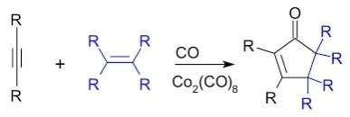
Pauson – Khand Reaction
The Pauson–Khand reaction (or PKR or PK-type reaction) is a chemical reaction described as a [2+2+1] cycloaddition between an alkyne, an alkene and carbon monoxide to form a α,β-cyclopentenone.
Reaction:

Slide 3
The reaction works with both terminal and internal alkynes although internal alkynes tend to give lower yields. The order of reactivity for the alkene is strained cyclic alkene > terminal alkene > disubstituted alkene > trisubstituted alkene.
Mechanism:
oxidative addition
alkene coordination
alkene insertion
Co insertion and
reductive elimination.

Slide 4
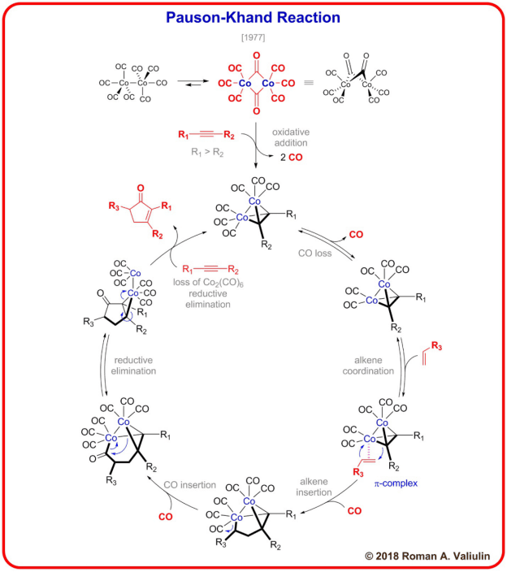

Slide 5
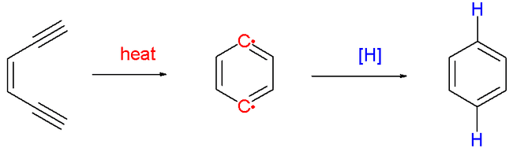
Bergmann Reaction
The Bergman cyclization or Bergman reaction or Bergman cycloaromatization is an organic reaction and more specifically a rearrangement reaction taking place when an enediyne is heated in presence of a suitable hydrogen donor. It is the most famous and well-studied member of the general class of cycloaromatization reactions.
Reaction :

Slide 6
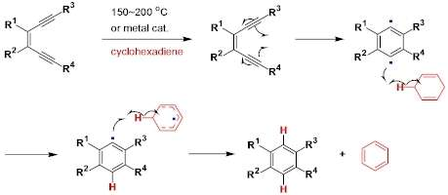
Mechanism:

Slide 7
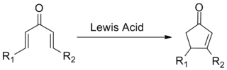
Nazarov Cyclization
The Nazarov cyclization reaction (often referred to as simply the Nazarov cyclization) is a chemical reaction used in organic chemistry for the synthesis of cyclopentenones. The reaction is typically divided into classical and modern variants, depending on the regents and substrates employed.
Reaction :

Slide 8
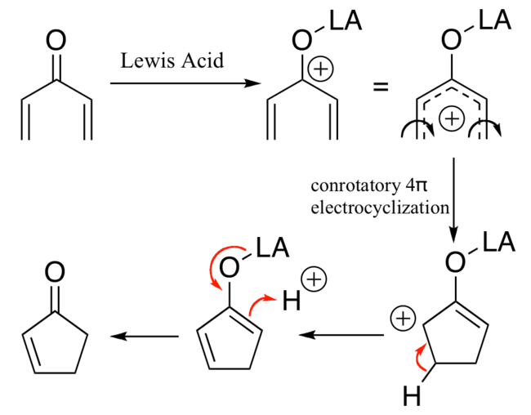

Slide 9
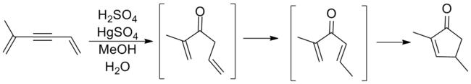
Classical Nazarov Cylizations
Though cyclizations following the general template above had been observed prior to Nazarov's involvement, it was his study of the rearrangements of allyl vinyl ketons that marked the first major examination of this process. Nazarov correctly reasoned that the allylic olefineisomerized in situ to form a divinyl ketone before ring closure to the cyclopentenone product. The reaction shown below involves an alkyne oxymercuration reaction a to generate the requisite ketone

Slide 10
Strong Lewis or protic acids are typically required for the reaction (e.g. TiCl₄, BF₃, MeSO₃H). These promoters are not compatible with sensitive functional groups, limiting the substrate scope.
Despite the mechanistic possibility for catalysis, multiple eauivalens of the promoter are often required in order to effect the reaction. This limits the atom economy of the reaction.
The elimination step is not regioselective; if multiple β-hydrogens are available for elimination, various products are often observed as mixtures. This is highly undesirable from an efficiency standpoint as arduous separtionis typically required.
Elimination destroys a potential sterocenter, decreasing the potential usefulness of the reaction.

Slide 11
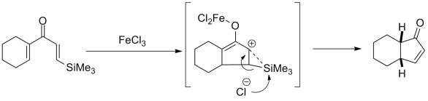
Modern variants :
The shortcomings noted above limit the usefulness of the Nazarov cyclization reaction in its canonical form. However, modifications to the reaction focused on remedying its issues continue to be an active area of academic research.In particular, the research has focused on a few key areas: rendering the reactioncatalytic in the promoter, effecting the reaction with more mild promoters to improve functional group tolerance, directing the regioselctivity of the elimination step, and improving the overall steroselectivity. These have been successful to varying degrees.

Slide 12
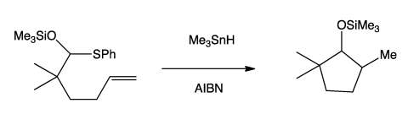
Radical - Olefin cyclization:
Radical cyclization reactions are organic chemical transormations hat yield cyclic products through radical intermediates. They usually proceed in three basic steps: selective radical generation, radical cyclization, and conversion of the cyclized radical to product.
Reaction:

Slide 13
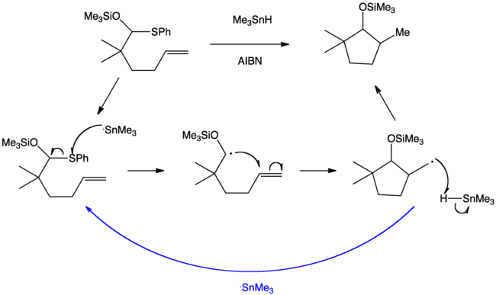

Slide 14
Inter conversion of ring system
Ring expansion and ring contraction reactions in the course of organic syntesis refer to a set of reactions which can lead to the expansion or contraction of an existing ring.

Slide 15
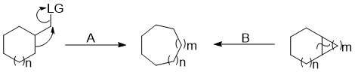
Ring Expansions
Ring expansions are valuable because they allow access to larger systems that are difficult to synthesize through a single cyclization due to the slow rate of formation
These are two types
1. Carbon insertion reactions
2. Heteroatom insertion reactions

Slide 16


Carbon insertion reactions
Carbon insertions are tremendously useful reactions which introduce an additional carbon atom into the ring. These reactions are used in the synthesis of many drugs and natural products. These can proceed through any of the mechanisms listed below.
Carbon insertion through migration to an exocyclic group
Carbon insertion through opening of a bicycle

Slide 17
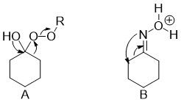
Heteroatom insertion reactions:
Heteroatom additions to rings can occur through ring expansions if not they are not done through de-novo ring synthesis. These introductions are primarily ring expansions because they often take place through migration/insertion pathways similar to those mentioned above for carbon.

Slide 18
Thank you

